Slide 1
¡A regatear!

Slide 2
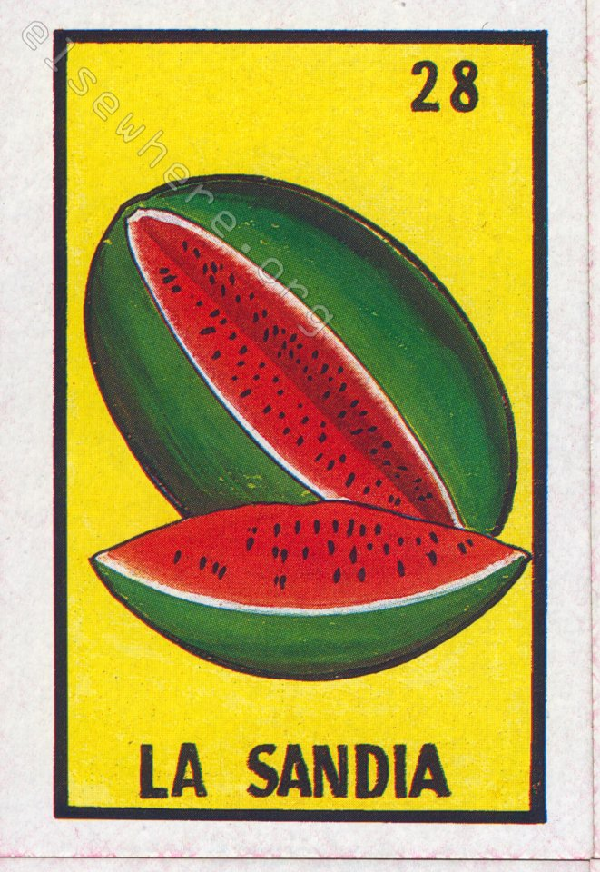
A: You’re working in the market. You can go as low as $2.
B: You’re looking for a bargain! You can go as high as $3.

Slide 3
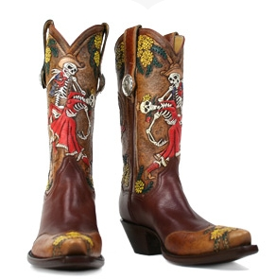
A: You’re looking for a bargain! You can go as high as $300
B: You’re working at your stall in the market! You can go as low as $250

Slide 4
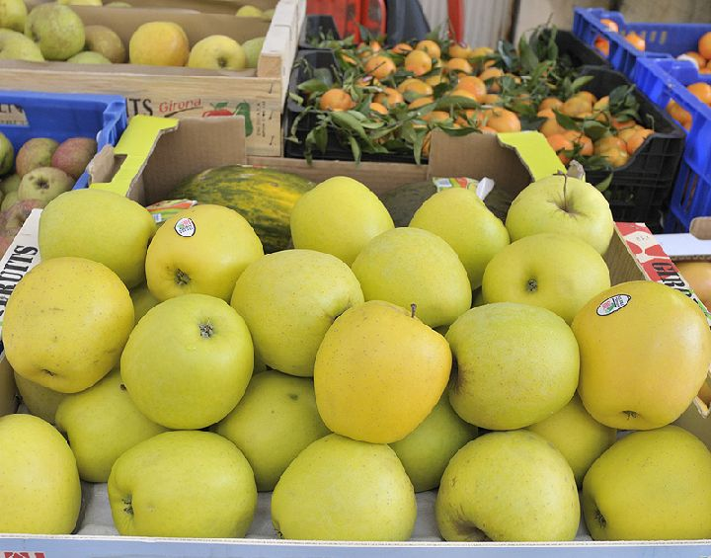
A: You’re looking for a bargain! You can go as high as $2
B: You’re working at your stall in the market! You can go as low as $1

Slide 5
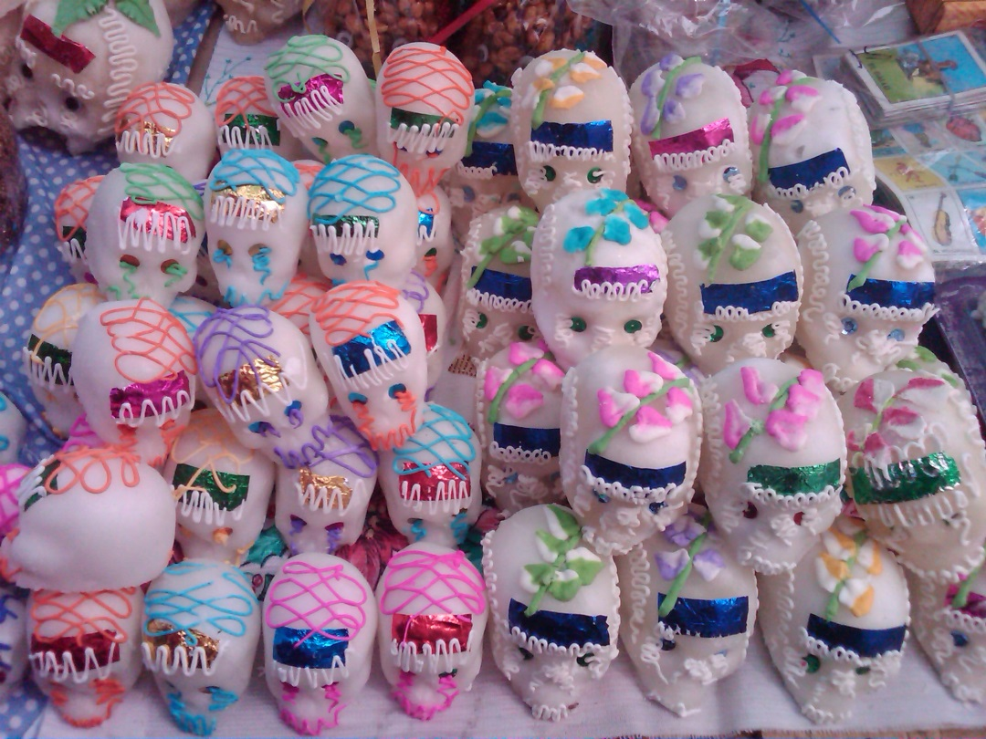
A: You’re working in the market. You can go as low as $2.
B: You’re looking for a bargain! You can go as high as $5.
Las calaveras

Slide 6
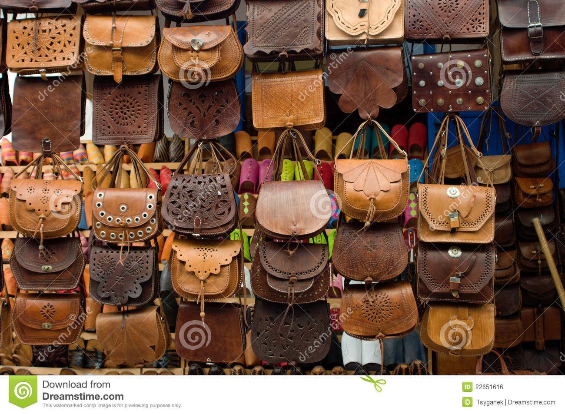
A: You’re looking for a bargain! You can go as high as $40
B: You’re working at your stall in the market! You can go as low as $30
Las bolsas de cuero

Slide 7
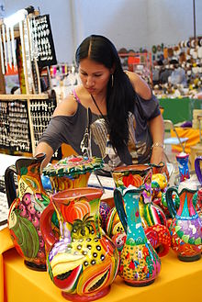
A: You’re working in the market. You can go as low as $25.
B: You’re looking for a bargain! You can go as high as $35.
Las jarras

Slide 8
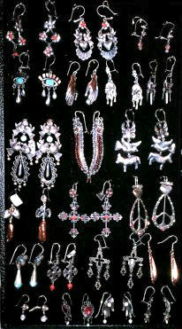
A: You’re looking for a bargain! You can go as high as $10
B: You’re working at your stall in the market! You can go as low as $3
los aretes

Slide 9
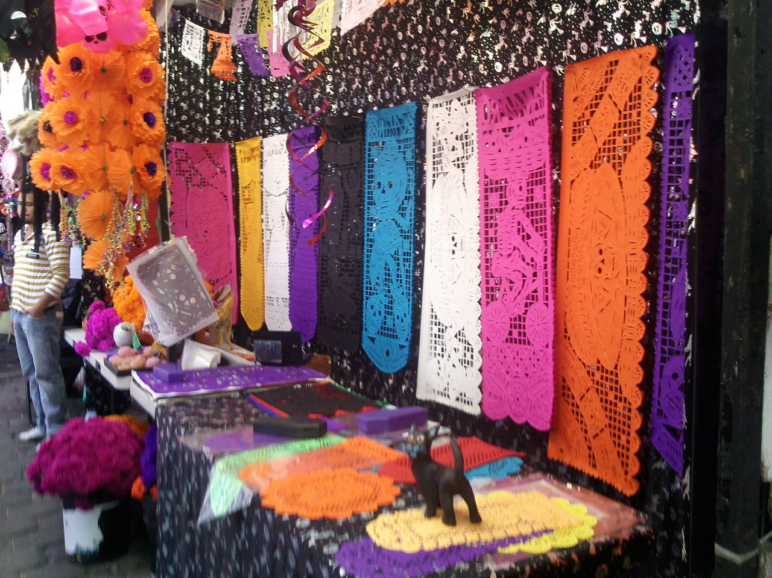
A: You’re working in the market. You can go as low as $15.
B: You’re looking for a bargain! You can go as high as $18.
Las decoraciones

